Slide 1
STAR 3
STAR to the Power of 3

Slide 2
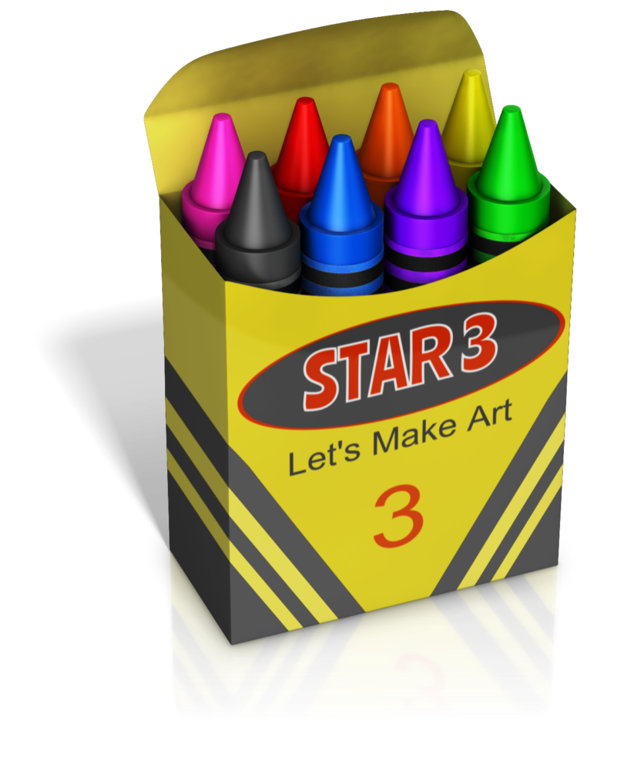
Area 3 has held multiple STAR events in our area.
If you are thinking of hosting one in your area, we can help you get started!
Here is a step-by-step guide

Slide 3
First Step- Establish a Committee
Considerations for Committee Members-
Members who desire to have a STAR
WIA Committee Member from your area
Those who have attended STAR at Camp Allen
Chapter Treasurer to handle money Issues
Your Area Coordinator
Talented members who are willing to share
Committee Meetings - Held throughout the year as plans are made, tweaked, and issues arise.
Agenda- Sent out at least a week before a Committee meeting so it reflects the needs and input from the committee.
First Meeting- Establish key principles –What will it look like? A weekend? A day? An evening? Etc. ?

Slide 4
Second Step–Determine Length and Time of Year
We decided on a one-day, all-day event on a Saturday in the Spring
Start Small and Expand from there.
The event location should be one that is centrally located, can accommodate crafts, has breakout rooms, and parking.
Time
Date

Slide 5
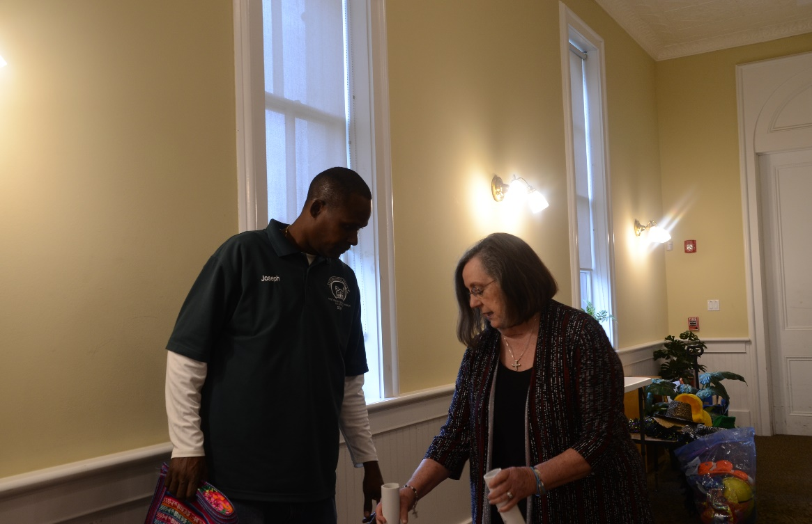
Third Step- Find a Place that is Free or Low Cost
We use a member’s church. The Church allows us to use the building for free.
We pay the Sexton, Joseph, $100 for his help:
Set-up on Friday and avaiable all day Saturday.
- Helps set up and take down tables.
- Handles the trash, helps us
cart our supplies, makes coffee, etc.

Slide 6
Fourth Step- Organize the Day
Determine the Time to Start and End
Time for food
Include an opening and closing session .
Most Important: Determine the Length of Each Session\Class and how many you will offer.

Slide 7
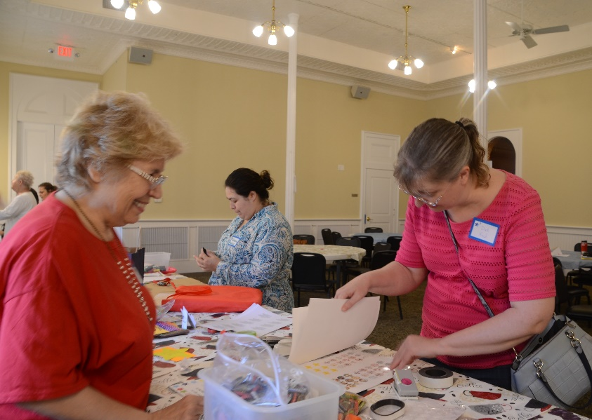
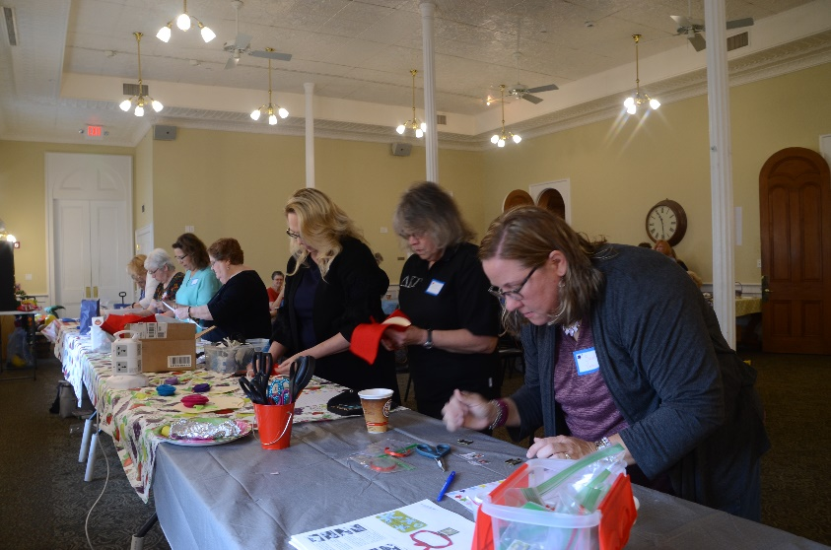
Fifth Step- Classes / Instructors / Class Size
Class Ideas - Painting, Jewelry Making, Silk Scarves, T-Shirt Bags, Writing, Music, Drama, Photography,
Instructors - Committee Members and
Members who taught at STAR or any one who wants to share their talents
Class Size –Determined by the time allotted for the session and space required.

Slide 8
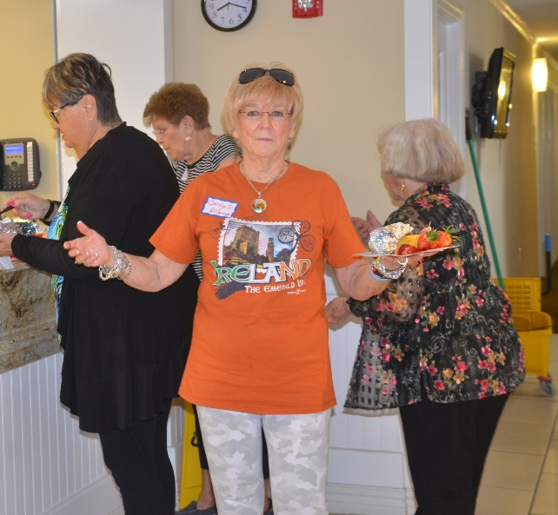
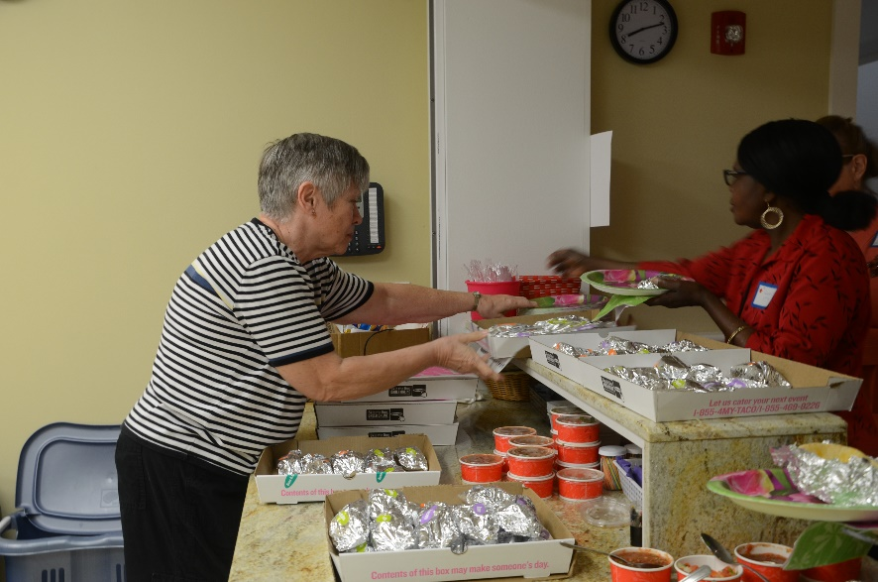
Sixth Step- The Food
Breakfast-Taco Cabana Breakfast Tacos- 1 ½ per person, Fruit,
Coffee, Juice
Lunch- Local Caterer- $12.00 each: Croissant, Sandwich, Chips, Cookie
Afternoon Snack-
Cookies
Coffee available all Morning;
water, tea, and soda available
all day

Slide 9
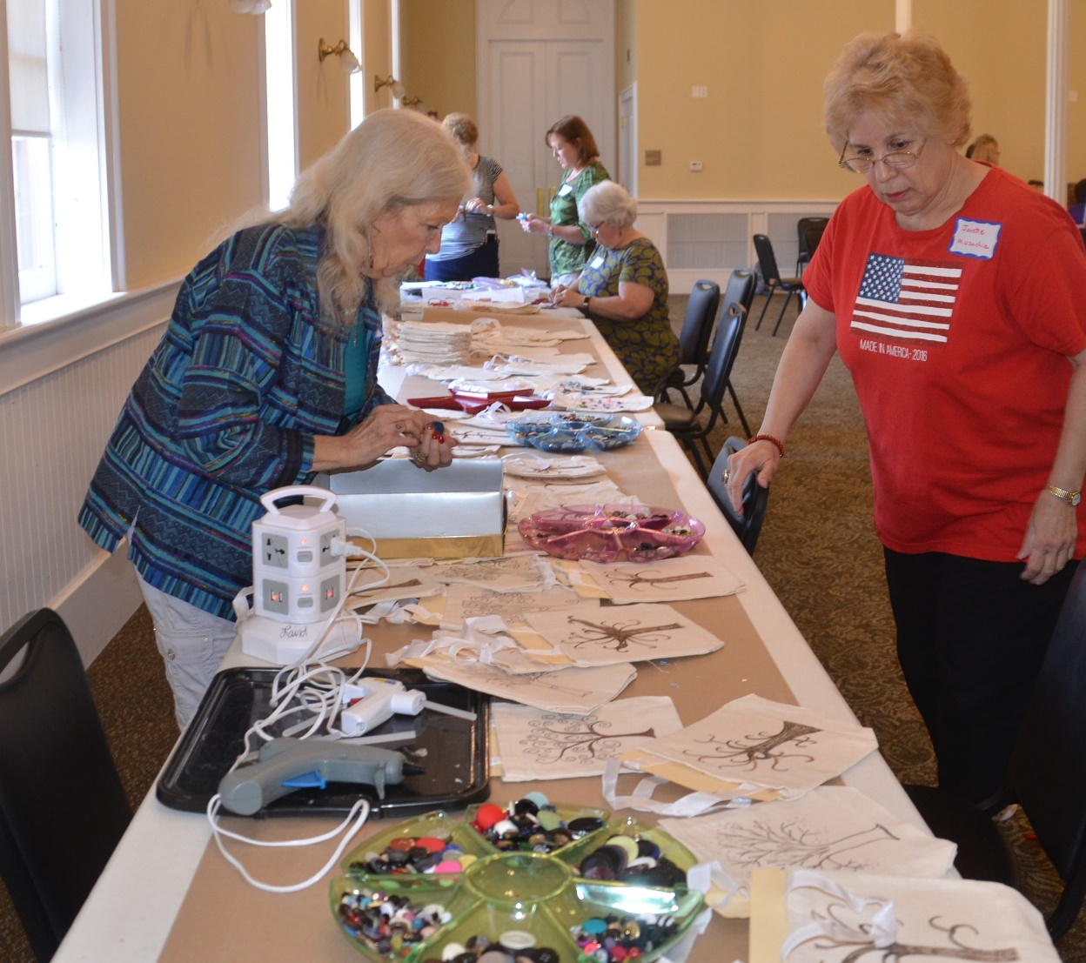
Seventh Step- Unique to Us
Early Educator Projects
We made Button Bags stuffed with Teacher Survival Kits.
We decorated 75 Journals with duct tape. Inside we wrote a note of encouragement and placed information about DKG
Also decorated Clipboards and memo pads.

Slide 10
Eighth Step- Determine A Reasonable Amount to Charge
Our Reimbursement Guidelines
$3.00 per Person- Large Session
$1.50 per Mini-Project-1 per person,
but most will do 2
$1.75 per-person-breakfast tacos
$1.04 per Person-Facility Charge
$0.60 assorted fruit per person
$12.00 - Lunch
After we added a small cushion to begin the next year, we decided on
$30.00 per person.
How Much Do
We Charge
to Attend STAR3

Slide 11
Ninth Step- Sign-Up
Get the Word Out
Area Coordinator -Advertise the Event
Email Chapter Presidents with a Save the Date early in the year
Newsletters– provide information about the event to be included in their news
Past STAR Attendees
“Biggest Cheerleaders”
How Do You Want Attendees to Register?
Sent Early bird for those who came last year directly to them, sent to all presidents by AC

Slide 12
Establish a Facebook Page
A great way to advertise and communicate
One member serves as the administrator and does the posting for the committee
Craft ideas are posted all year
Check out our page: Area 3 STAR
This Photo by Unknown Author is licensed under CC BY-NC

Slide 13
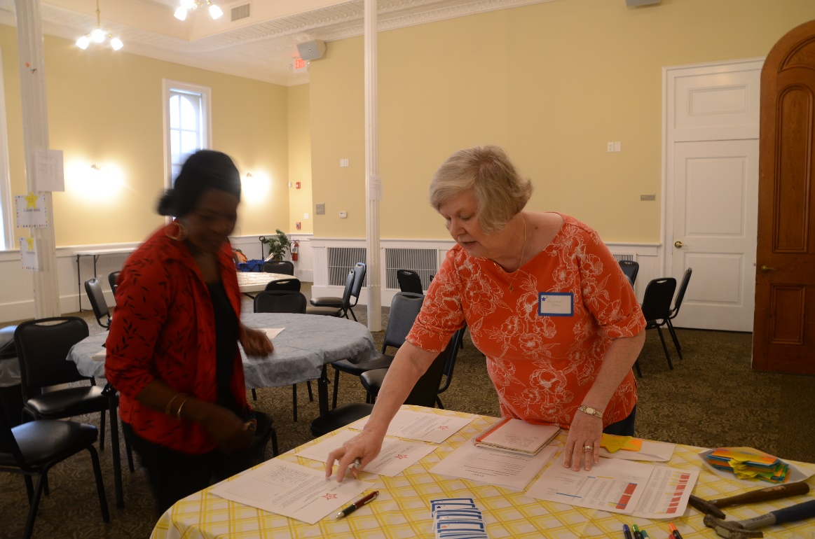
Eleventh Step- Forms and Assistance
Here is Where We Come In
We will share any form or communication tool with you
Evaluation Form
The most important form- we use it to make adjustments based on input from attendees

Slide 14
Last Step- Don’t Reinvent the Wheel
We Invite You to Attend Our Event to See it in Action!
Annual
STAR3
April 1, 2023

Slide 15
For Questions:
Dr. Barbara Derrick
BLSDerrick@aol.com
This Photo by Unknown Author is licensed under CC BY-NC

